Slide 1
Fantasy Basketball Draft Kit
By Robert Cheer

Slide 2
About Fantasy Basketball
Fantasy Basketball is a game generally played with anywhere from 8-16 players that draft NBA players to formulate their teams.
There are two main formats, head to head where you have a different opponent each week and the top teams make a playoff round, and rotisserie (roto) in which you aggregate all stats for the entire season. In roto, if you are in a 12 team league and are first in a category, you receive 12 points, 2nd in a category receives 11 points and if you are last you receive 1 point.
Stat categories (Points, Rebounds, Assists, Steals, Blocks, Three Pointers, Turnovers, FG% (shots made/shots taken), and FT% (free throws made/free throws taken)
My project focuses mainly on head to head, but scorings can be used in any format.

Slide 3
Head to Head Rules
Each week you are matched up against an opponent. You can put up to 10 players in your lineup each day, with the following position slots (PG,SG,SF,PF,C,C, G,F,Util,Util). You can put anyone in the Util slot, while G can be either PG or SG and F can be either SF or PF.
For all the players inserted into your lineup, stats are aggregated for each game for the entire week. Each category that you have a higher score than your opponent (other than turnovers that you want a lower number) gives you a win, and if you have a lower score you get a loss. For example, if I beat my opponent in 7 categories and they beat me in 2, I receive 7 wins and 2 losses. If there is a tie, ties are counted as half of a win and half of a loss when determining playoff seeding.
Generally 6 teams make the playoffs, with the top 2 getting a bye.

Slide 4
Why Fantasy Basketball?
Sports Bring people together. This is a picture of the warriors championship parade, people of all different backgrounds can come together with the people in their city and have pride and joy over a common cause.
Fantasy basketball along with other fantasy sports can allow friends from far away to come together over competing against each other in a friendly game. It has almost become the main method in which I stay in touch with friends from high school and college.

Slide 5
Creating a Ranking System
The first step of the process was to create a ranking system. Each of the top 200 players by season. Each player was ranked on each category by the amount of standard deviations above the mean. Here were the top 5 players in 2017, you may be surprised that there is no Lebron James or Russell Westbrook on the list.
1) Anthony Davis 2) Steph Curry 3) James Harden 4) Kevin Durant 5) Karl Towns

Slide 6
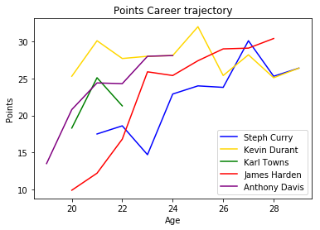
Gathering the Data: What Impacts Performance?
My intuition was that if the team has no changes, you can relatively accurately predict next season by just looking at the career trajectory and age of a player.
In the 90s and 2000s, stars didn’t change teams very much, so by just using last seasons data you could come up with a relatively accurate prediction for next year:
But how do you predict changes such as James Harden going from 10 points to 25 in just two seasons. Steph Curry going from 15 to 23 points in his age 24 season. What are the common threads?
From historical data we know that Harden changed teams, going from a team with established stars Kevin Durant and Russell Westbrook to a Houston team where he would be the main guy. Steph Curry at age 24 saw Monta Ellis traded away, giving him the keys to be the primary ball handler.

Slide 7
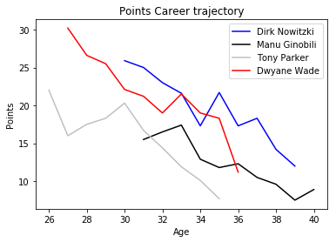
Evaluating Non-Linear Inputs
From slide 6, we saw that those star players still in the prime of their career have tended to get better as they get older. However, when we look at older stars, we actually see the opposite:
We can interpret this deviation as a non linear trend. Players career primes are generally in their upper 20s (25-30), varying slightly by player. Because of this we need to incorporate not just age as a variable but age squared.

Slide 8
The Star of the Show
In basketball, there are only 5 players on a court, so one player can impact the others on the court dramatically. In the NBA in particular, one player generally calls the play and determines how a play is going to be run. Adding or losing a star can have dramatic impact to your production
A prime example of that is the rise of Russell Westbrook following the departure of Kevin Durant
Anthony Davis finished first among the fantasy basketball ranks last season following the injury to Demarcus Cousins

Slide 9
Stars continued…
But what happens when a player leaves for a team with no established star?
James Harden and Victor Oladipo went on to be stars in their own way, but each player is effected in their own way.

Slide 10
What happens when you leave to a team with already established stars?
Going onto a team and switching from being the primary player to a secondary or even third option can really hurt your production.
Kevin Love went from the primary option in Minnesota to a stretch 4 shooter on Cleveland
Kevin Durant left a team with Westbrook but joined Steph Curry and his production was left unchanged

Slide 11
Model Design: Feature Engineering
After getting the data from basketball reference, I stored all of my data in a PostgreSQL database and started engineering combinatory features.
In order to find signal in teammates, I took the usage rate multiplied by the minutes of each players teammates, then took the maximum usage*min of the group of teammates from last season.
For Russell Westbrook, his usage*min goes as high as 1200, putting him up at our near the top along with James Harden and a few others. This doesn’t allow for as many touches for teammates, throttling their performance. This allows player like Victor Oladipo to excel when traded away from his team to other teams that don’t have these ball dominant players.
Another feature engineered was the rank of usage on your team based on last seasons statistics. If you are traded to another team, your usage rank may change, which can cause your stats to change (especially if you become the primary option). I used window functions in SQL to rank based on usage*min from the past season.

Slide 12
Model: Important Features
My model intook data from past performance, particularly the last two years and the career stats of a player. The most important feature in predicting any individual stat was their last years average in that statistic
Teammates are also critical to the success of a player, having teammates that share the ball creates opportunities for success.
I also incorporated advanced statistics such as value over replacement and boxplusminus to predict which players were showing improvement and likely to get more playing time as a result.
Potential missing features: While I was able to get some signal out of teammate usage, I think the real stat that would have been important if I could find it is the number of dribbles your teammates take. Players that dribble the ball a lot are often wasting time and/or are difficult to play with.

Slide 13
Error Testing: Cross Validation and Model Selection
Test were run using data starting from the 2008-09 season up until the 2016-17 season (may add more data). Cross validated using k-fold cross validation ran grid searches on gradient boosting while also testing Linear Regression and Rectified Linear Unit Neural Networks.
Error Rates were tested against a baseline of choosing last seasons average.
Linear Regression model was selected based on the lowest error on the test sets.
Final model was run on 2017-18 data.

Slide 14
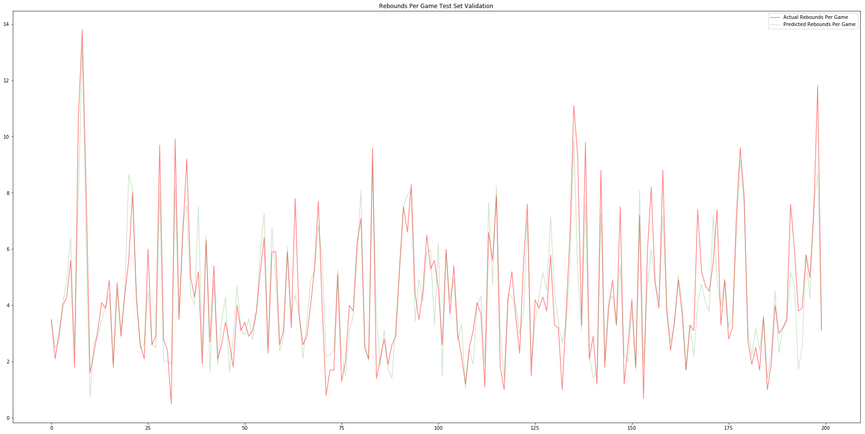

Slide 15
Results: Comparing to Yahoo Rankings
After selecting the final model, loaded in Yahoos preseason rankings from 2017-18 season.
Created rankings based on my predicted model
Compared my rankings as well as yahoos rankings to the actual rankings using Rank Bias Overlap. My model beat all Yahoo Experts at each level of the top n sample players.

Slide 16
Predicting Next Season
With the departure of Demarcus Cousins, Anthony Davis is projected to retain his number 1 spot.
Gordon Hayward is expected to fall the most coming off an injury and joining a stacked Celtics team with young guys that could challenge him for playing time
Meanwhile, Buddy Hield and Pascal Siakam who both gained starting spots on teams without ball dominant players are expected to rise the most.

Slide 17
Next Steps
1) Get more data for rookies and Olympic team players. These are two points of variance that my data doesn’t explain.
2) I would like to create a class where you could compare your team to other teams and see what categories you can potentially win, which could help more advanced players
3) Trade Evaluator, look at potential trades, whether or not they are fair and how they could potentially benefit both sides.

